Slide 1
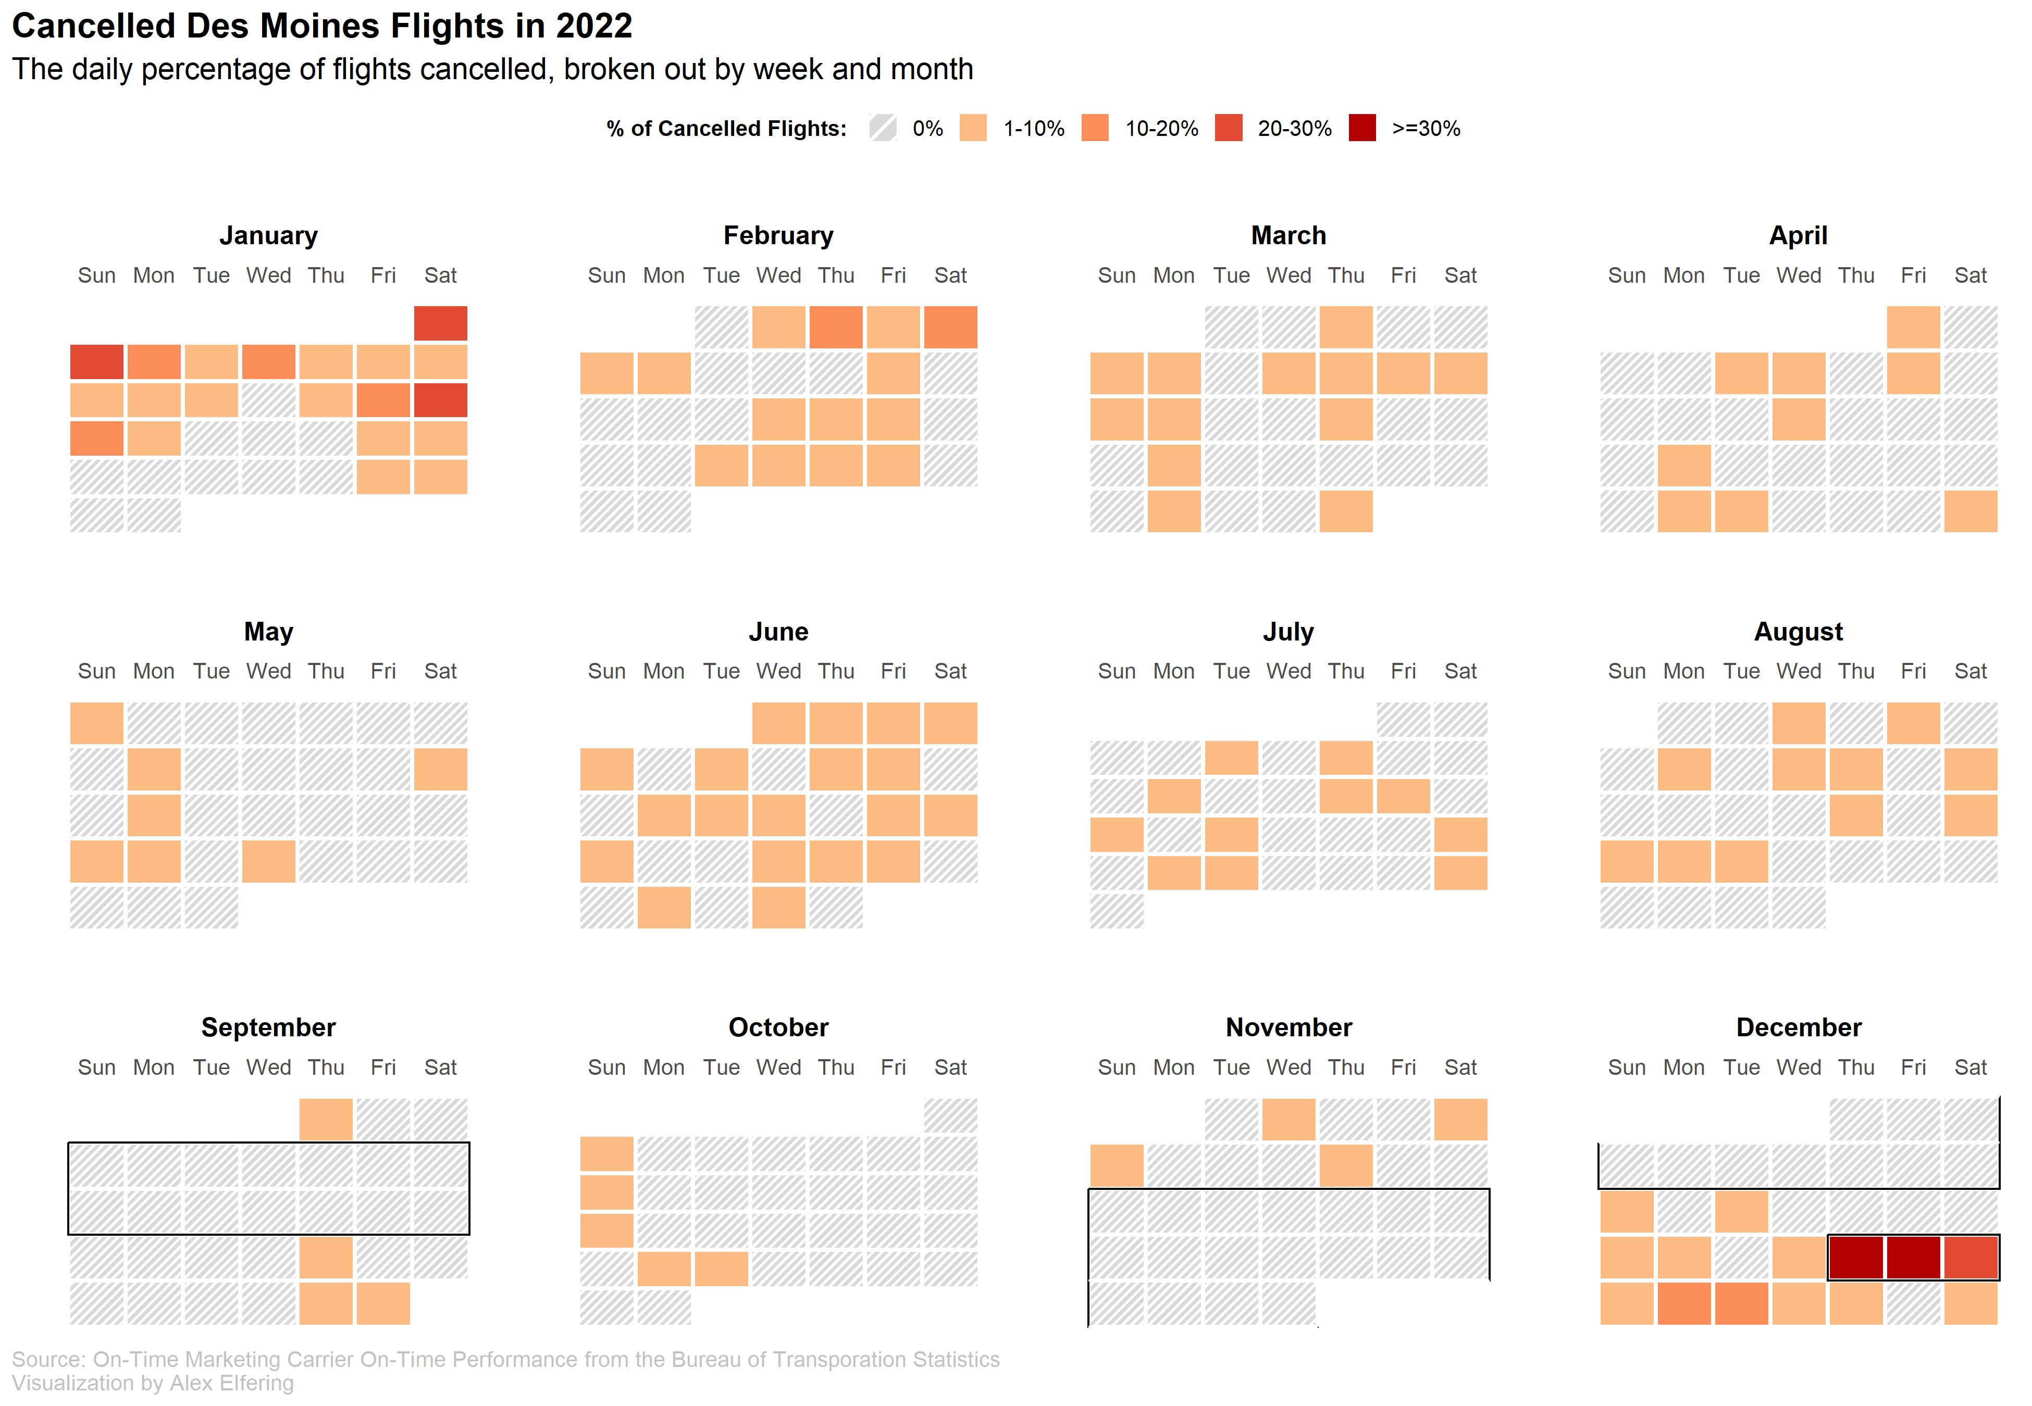
Des Moines had 6 weeks with
no cancellations, but only in the fall
Winter Storm Elliot caused more delays during
Christmas than in all of Sept-Nov

